Slide 1

Streamlining Non-Profit Operations: A Volunteer and Donation Management System
This presentation outlines a comprehensive system designed to enhance the efficiency and effectiveness of non-profit organizations by streamlining volunteer management, donation processing, and communication.
- By Group 33

Slide 2
Problem Statement
Non-profits often struggle with manual processes for volunteer recruitment and scheduling.
Tracking donations, managing donor information, and ensuring transparency can be challenging.
Connecting volunteers with the right opportunities and matching them with donor needs is difficult.

Slide 3

Key Challenges
Lack of centralized system for volunteer management.
Inefficient donation tracking and donor engagement.
Limited communication and collaboration between stakeholders.

Slide 4





System Overview
Centralized Platform
1
Connects non-profits, volunteers, and donors.
Volunteer Management
2
Recruitment, scheduling, tracking, and evaluation.
Donation Processing
3
Online donations, receipt generation, and reporting.
Communication Tools
4
Messaging, forums, and announcements.
Reporting and Analytics
5
Track impact and resource allocation.

Slide 5




Roles
Non-profit Admin
Volunteer Coordinator
Active Volunteer
Donor
Manages organization operations.
Enterprise: Non Profit enterprise
Organization: Volunteer Management
Enterprise: Community Support
Organization: Donation Management
Enterprise: Non Profit enterprise
Organization: Volunteer Management

Slide 6




Roles
Data Analyst
Aid Recipient
Aid Coordinator
Campaign Organizer
Enterprise: Corporate Donor Enterprise
Organization: Analytics and Reporting
Enterprise: Public Service
Enterprise
Organization: Recipient
Registration
Enterprise: Non Profit Enterprise
Organization: Aid Distribution
Enterprise: Corporate Donor Enterprise
Organization: Campaign Management

Slide 7
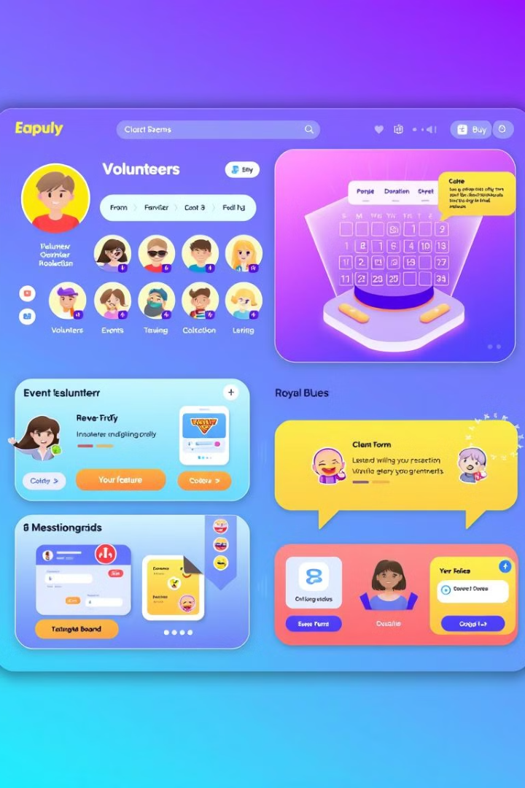
Features and Functionalities
Volunteer Profiles
Notification Alerts
Match volunteers to opportunities based on skills and interests.
Stay updated with real-time alerts about schedules, and important updates etc.
Donation Forms
Donation Tracking
Secure online processing of contributions.
Improve communication and collaboration among stakeholders.

Slide 8

Benefits to Non-Profits
1
Simplified volunteer management and recruitment.
2
Streamlined donation processing and donor engagement.
3
Improved communication and collaboration between stakeholders.

Slide 9
Benefits to Volunteers
Easy Access
1
Find and sign up for opportunities.
Personalized Matches
2
Connect with relevant causes.
Track Impact
3
See the difference they make.

Slide 10

Benefits to Donors
1
Transparency
See where their donations go.
2
Impact
Witness the results of their generosity.
3
Ease
Make secure online donations.

Slide 11

Conclusion
This volunteer and donation management system has the potential to revolutionize non-profit operations, making it easier for them to connect with volunteers and donors, maximize their impact, and create a positive change in the world. Next steps involve further development, testing, and piloting the system with partner organizations to gather feedback and refine the platform.

